Slide 1
Sammamish-Juanita 115 kV Project
Route Siting Project
November 2012
Gene Lohrmeyer
GeoEngineers
Notes:
1

Slide 2
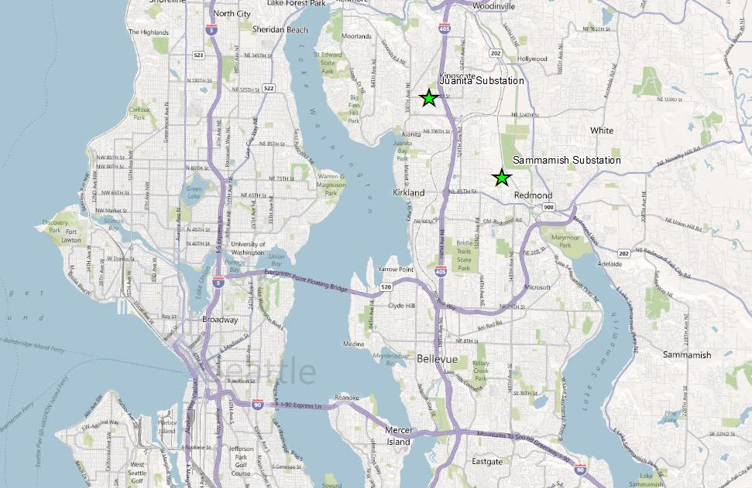

GeoRoute Selection Model

Slide 3
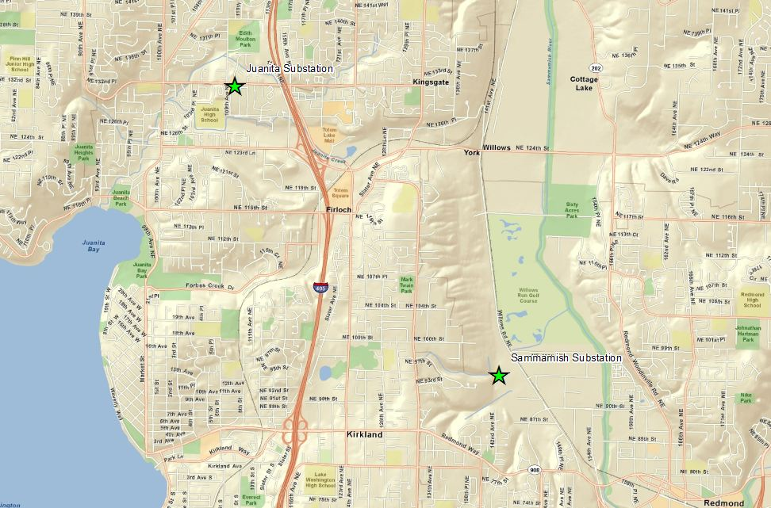
GeoRoute Selection Model

Slide 4
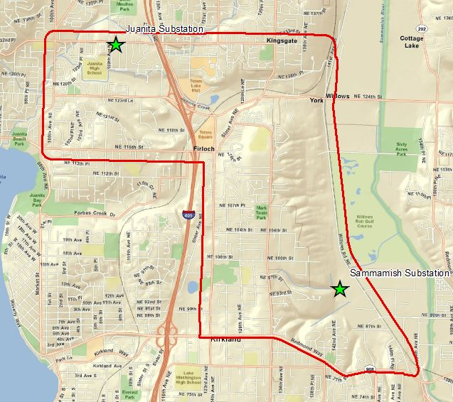
PSE Needs
GeoRoute Selection Model
Help determine preferred route between substations – need alternatives
Demonstrate and defend route selection process in public meetings

Slide 5
Issues
GeoRoute Selection Model
Multiple competing values
  Engineering
  Community
  Environment
Other non-GIS efforts by PSE resulted in no consensus
  Professional Judgement
  Criterium

Slide 6
How would you help PSE with this problem?
GeoRoute Selection Model

Slide 7
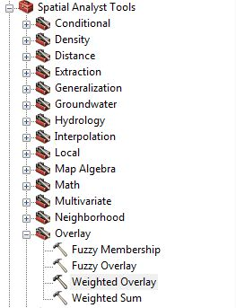
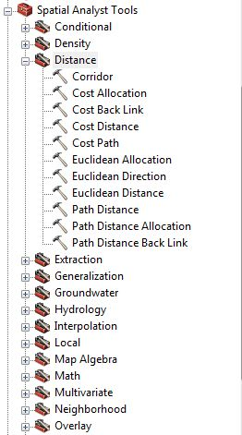
GeoRoute Selection Model
GeoEngineers Solution
Develop a geoprocessing model
  Combine datasets using weighted overlay tool
  Least cost path analysis using distance tools
    Accumulated Cost

Slide 8
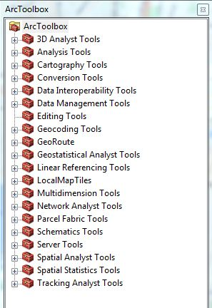
What is Geoprocessing?
GeoRoute Selection Model
Allows you to automate GIS tasks and perform spatial analysis and modeling
Everything in the toolbox can be used in a geoprocessing model

Slide 9
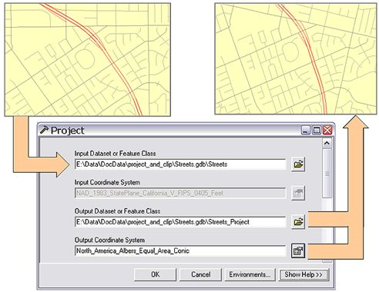
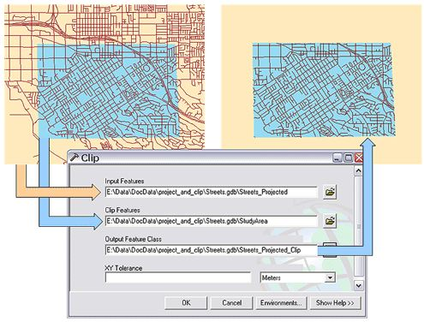
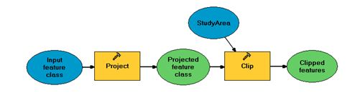
Geoprocessing Example
GeoRoute Selection Model
20 datasets from various sources
Reproject and clip each dataset to a project boundary

Slide 10
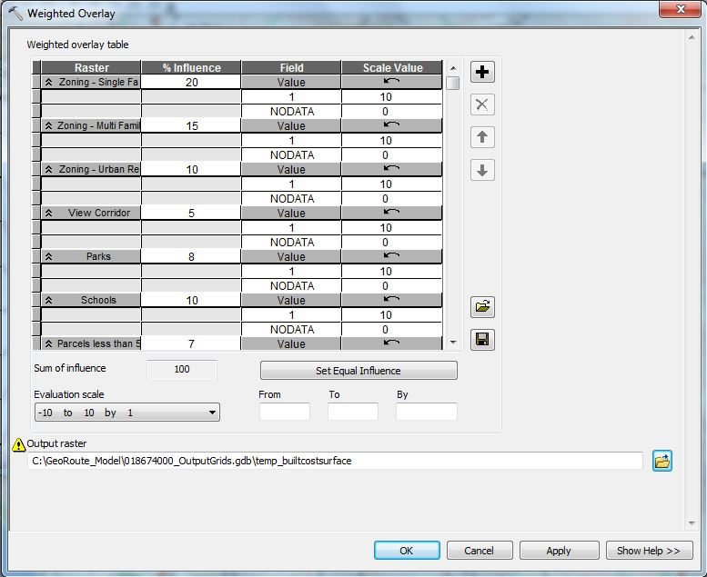
Weighted Overlay Tool
GeoRoute Selection Model
Allows you to combine rasters of varying importance
  Why rasters?
  Scale (in = 10, out = 0)

Slide 11
GeoRoute Tasks
GeoRoute Selection Model
Collect existing jurisdictional GIS Data
  Kirkland, Redmond, Dept of F&W
Clip to project boundary and convert to raster
Assign data to either Built, Natural Environment, Engineering or Opportunity groups
  More flexibility for analyzing alternatives
Weighted Overlay Tool
  Weight and combine datasets in each group
  Weight and combine Built, Nat Env and Eng groups (Avoidance Areas)
  Weight and combine Avoidance Areas with Opportunities
Distance Tools
  Least Cost Path Analysis

Slide 12
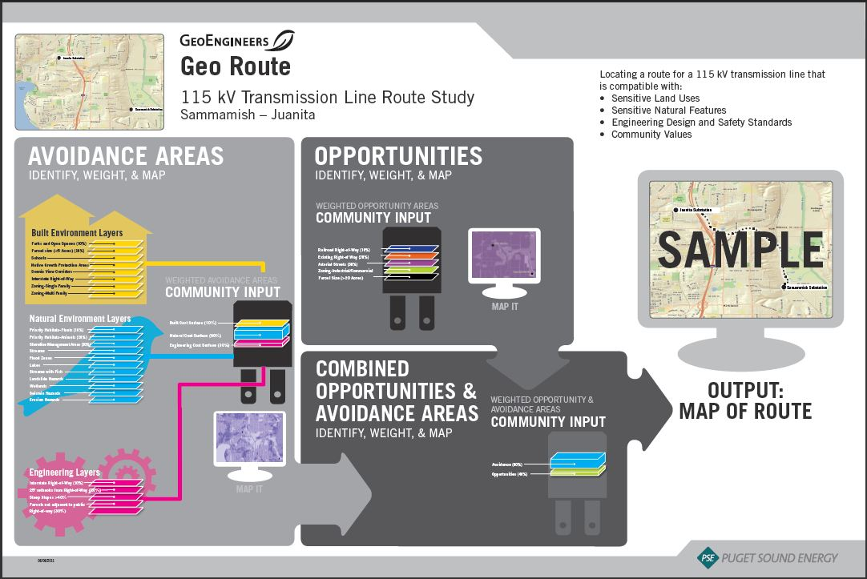
Model Overview
GeoRoute Selection Model
Conceptual

Slide 13
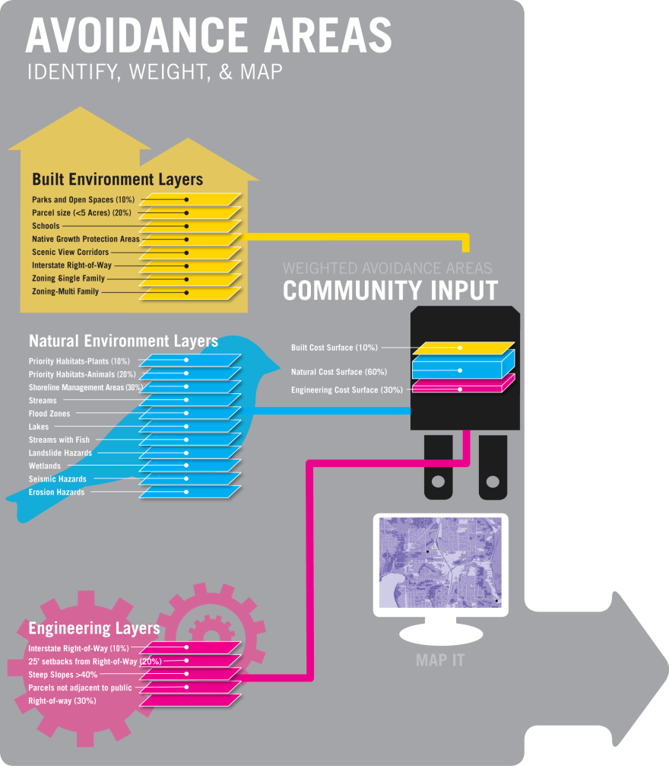
GeoRoute Selection Model

Slide 14
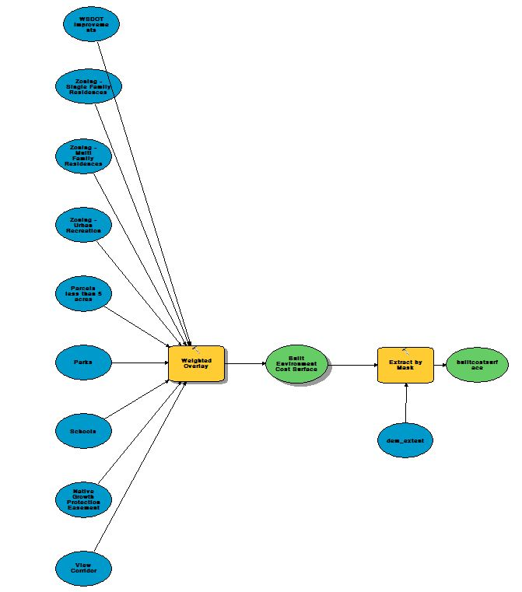

GeoRoute Selection Model
Built
Environment

Slide 15

GeoRoute Selection Model
Built Environment Data Layers
Data Reviewed, Within Study Area | Data Reviewed, Not Within Study Area
Single Family Residential Zoning | Cultural/Historic Resources
Multi Family Residential Zoning | Areas of property disputes
Urban Recreation Zoning | Open space taxation parcels
Parcel Size < 5 acres | Airports
Local Parks | Scenic Highways
Native Growth Protection Areas | Surface Mining
View Corridors (Redmond) | Parcels Fronting Local Access Streets

Slide 16
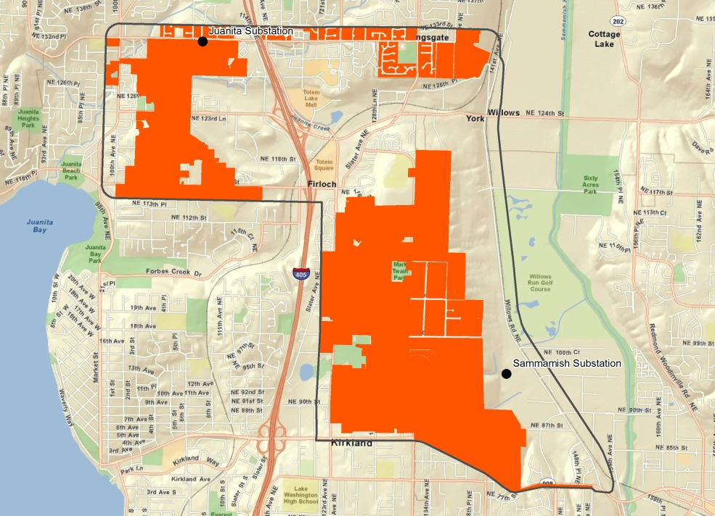
GeoRoute Selection Model
Single Family Residential Zoning

Slide 17
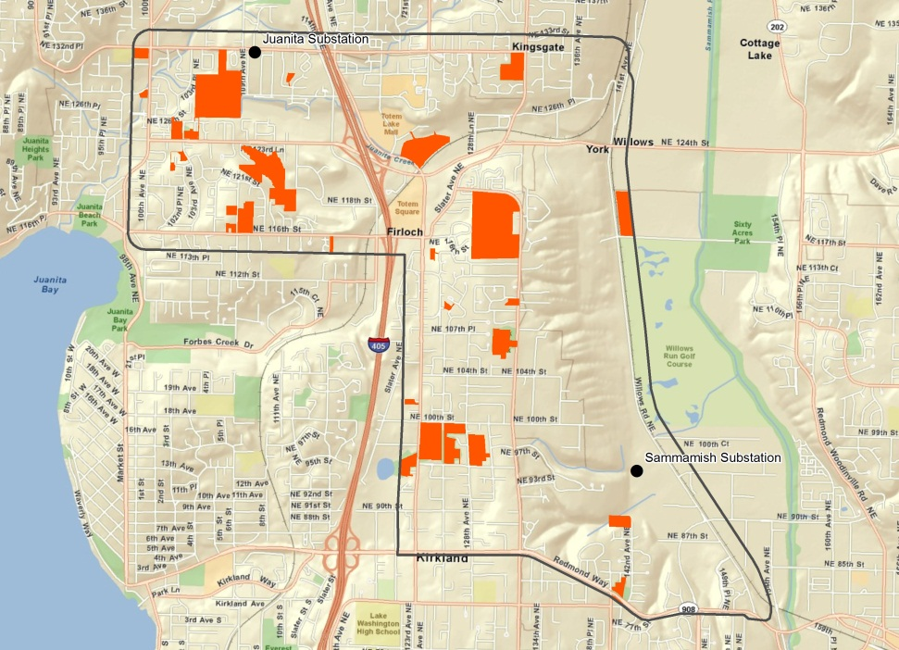
GeoRoute Selection Model
Schools and Parks

Slide 18
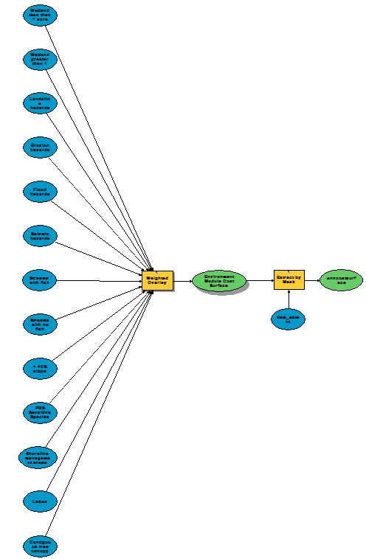

GeoRoute Selection Model
Natural
Environment

Slide 19

GeoRoute Selection Model
Natural Environment Data Layers
Data Reviewed, Within Study Area |  | Data Reviewed, Not within Study Area
Wetlands | Shoreline Jurisdiction | WA Natural Heritage Program areas
Landslide Hazards | Lakes
Seismic Hazards | 100 year floodplain
Erosion Hazards | Contiguous Tree Canopy
Streams
Steep Slopes >40%
Sensitive Species (WDFW)

Slide 20
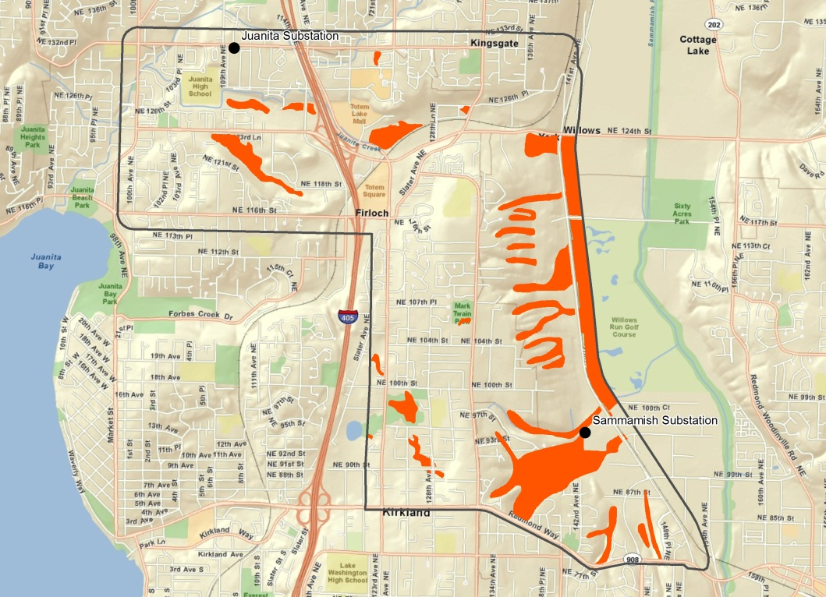
Wetlands
GeoRoute Selection Model
Wetlands

Slide 21
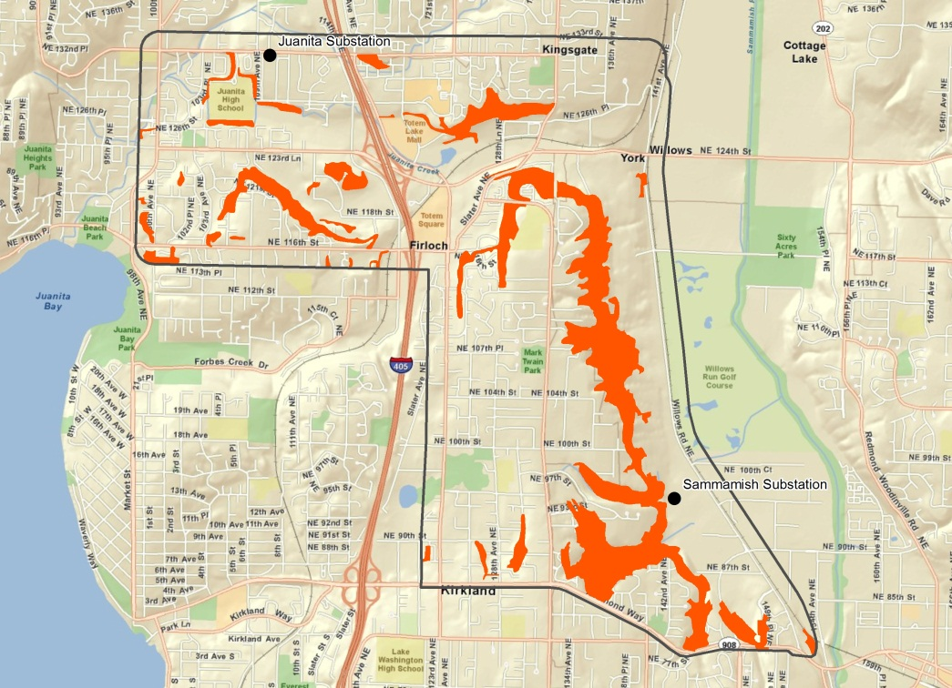
GeoRoute Selection Model
Landslides

Slide 22
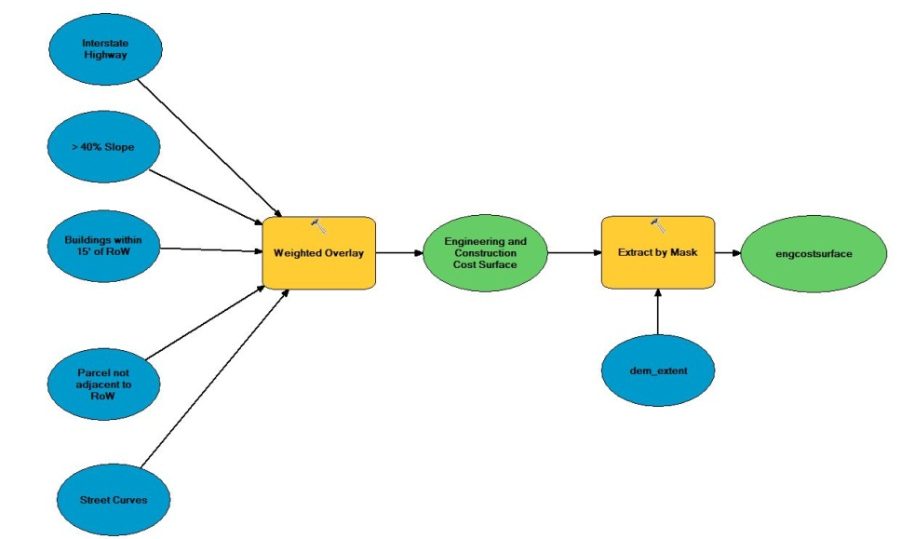

GeoRoute Selection Model
Engineering

Slide 23

GeoRoute Selection Model
Engineering Data Layers
Data Reviewed, Within Study Area | Data Reviewed, Not Within Study Area
Curved Streets | BPA Crossing
Structures within 15’ of R/W
Parcels not adjacent to Public R/W
Interstate Highway Crossing
Steep Slopes >40%
Future WSDOT Improvement Areas

Slide 24
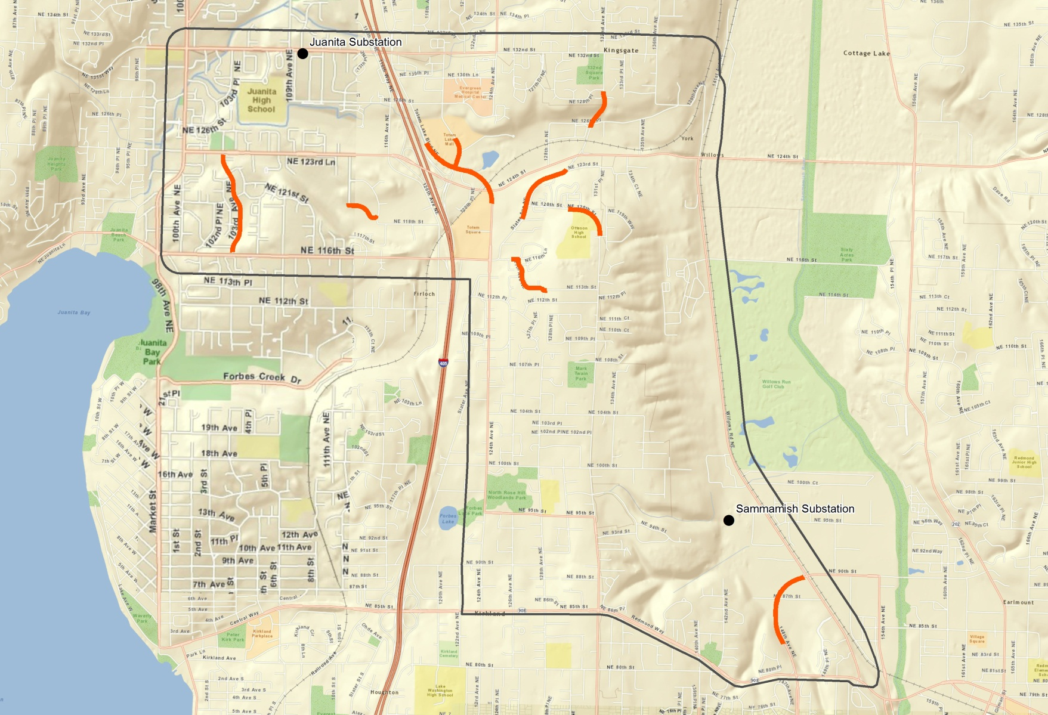
GeoRoute Selection Model
Street Curves

Slide 25
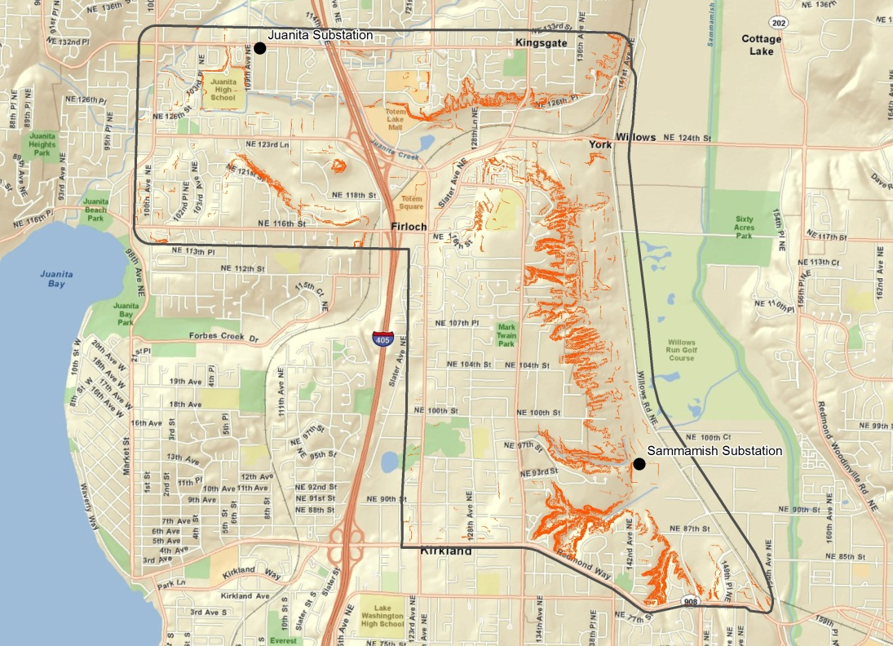
GeoRoute Selection Model
Steep Slopes >40%

Slide 26
GeoRoute Selection Model
Built Environment Data Layers Weights
Data Reviewed, Within Study Area | Weight (%)
Single Family Residential Zoning | 20
Multi Family Residential Zoning | 15
Urban Recreation Zoning | 10
Parcel Size < 5 acres | 7
Local Parks | 8
Native Growth Protection Areas | 15
View Corridors (Redmond) | 5
Schools | 10
Native Growth Protection Easement | 15
WSDOT Improvements | 10

Slide 27
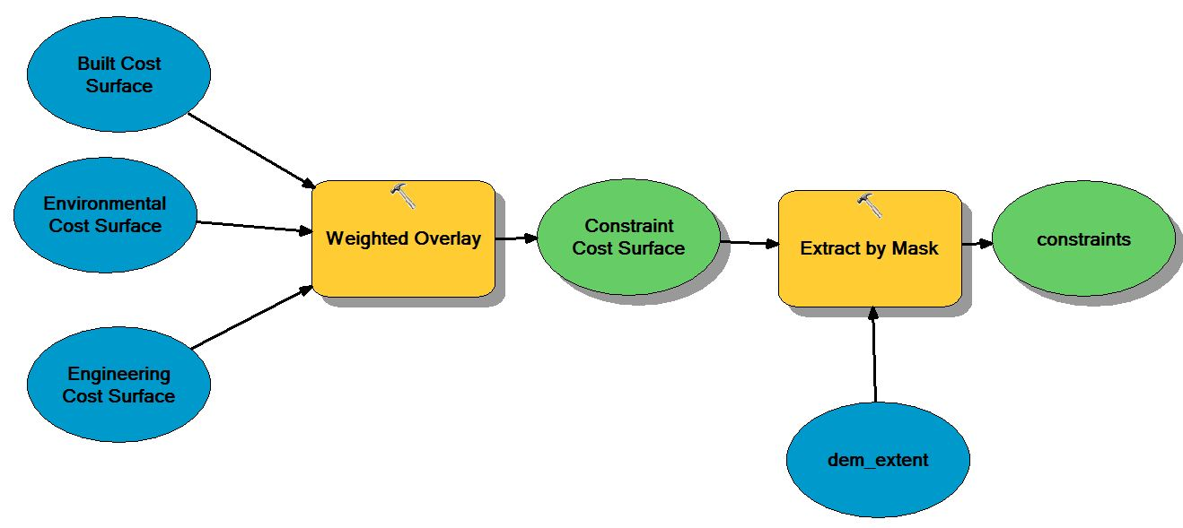
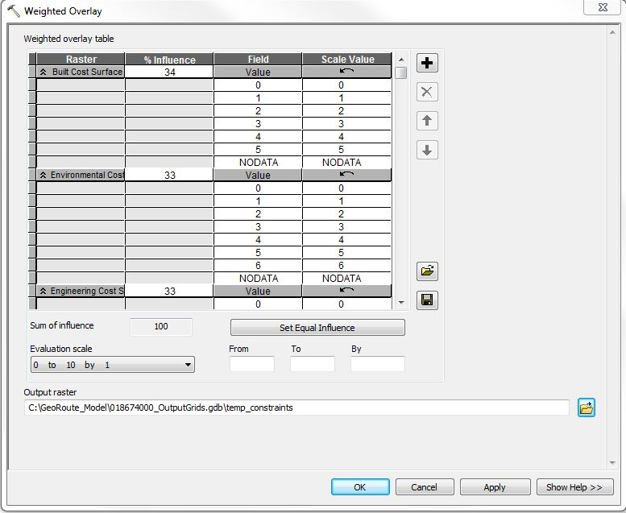
GeoRoute Selection Model

Slide 28

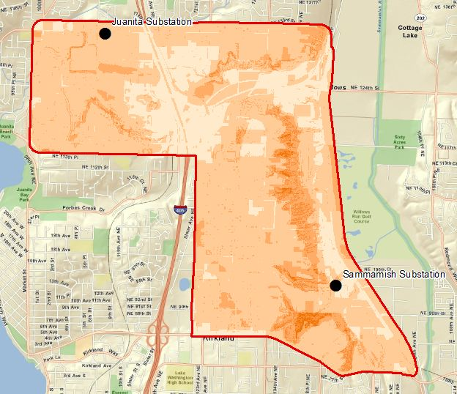


GeoRoute Selection Model
Combined and weighted avoidance groups
34%
33%
33%

Slide 29
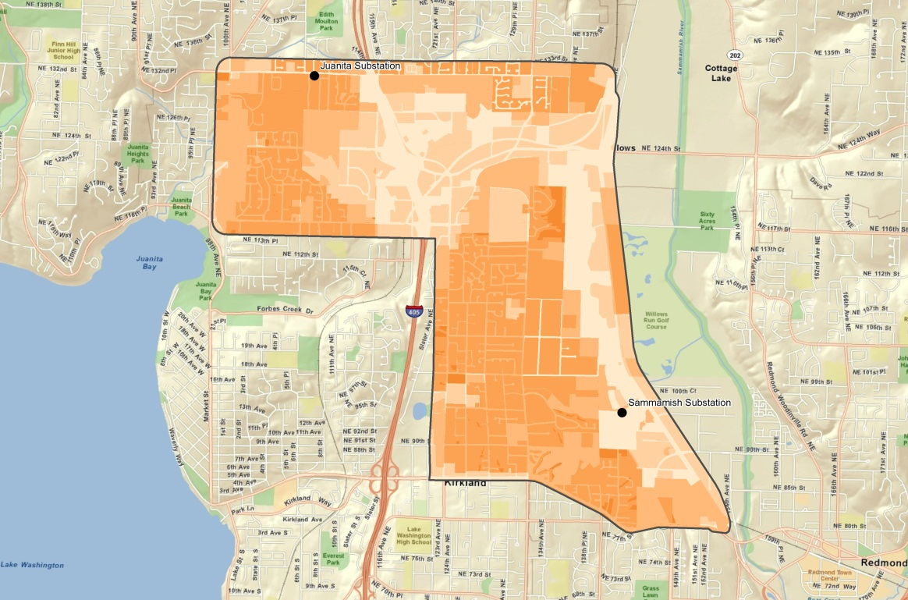
GeoRoute Selection Model
Built Environment Criteria
100%
0%
0%

Slide 30
Model Overview
GeoRoute Selection Model

Slide 31
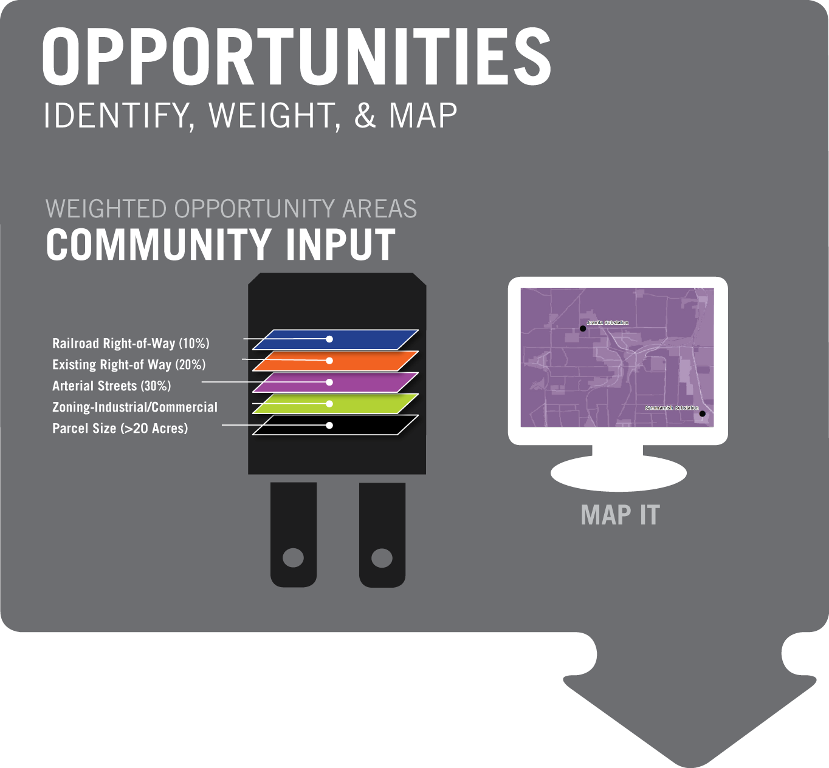
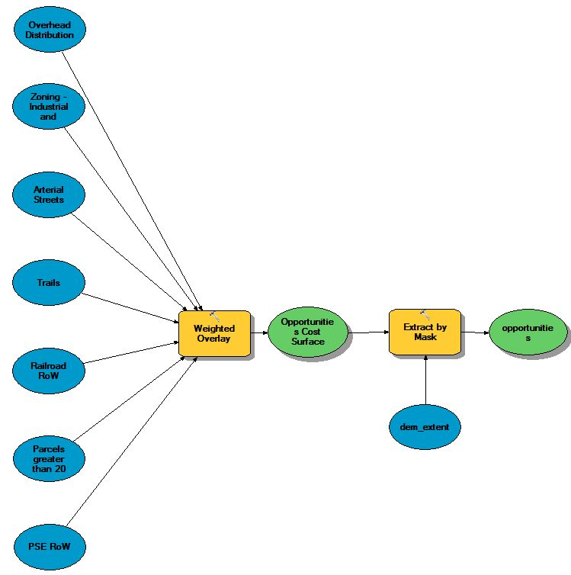
GeoRoute Selection Model

Slide 32
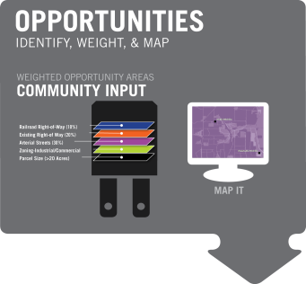
GeoRoute Selection Model
Opportunities Data Layers
Data Reviewed, Used for Modeling | Data Reviewed, Not Used for Modeling
Commercial/Industrial Zoning | Open Vegetative Cover
Arterial Street | Community Plan Compatibility
Trails R/W
Railroad R/W
Parcel size > 20 acres
Existing PSE Rights-of-Way
Existing Overhead Distribution

Slide 33
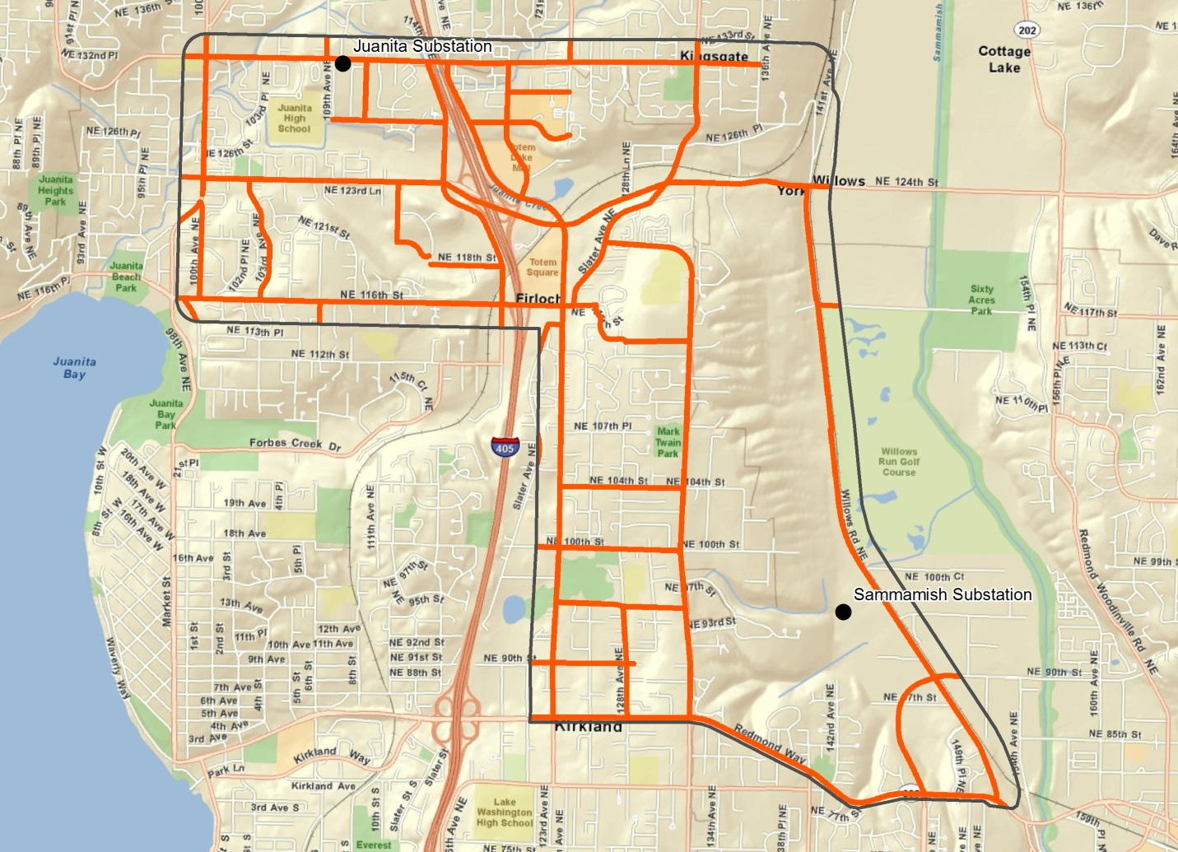
GeoRoute Selection Model
Arterial Streets
Notes:
Joanne gives presentation on GeoRoute model
Note: copy of GeoRoute Model public involvement poster will be in the AG’s meeting packets
Example map of things we are trying to avoid
Environmental Example
Landslide Hazards (+ study area map)

Slide 34
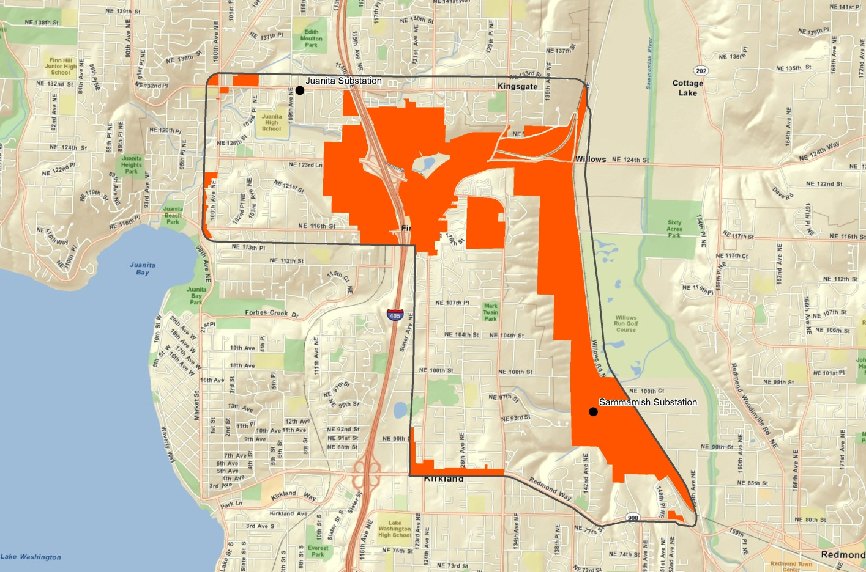
GeoRoute Selection Model
Industrial/Commercial Zoning

Slide 35
Model Overview
GeoRoute Selection Model

Slide 36


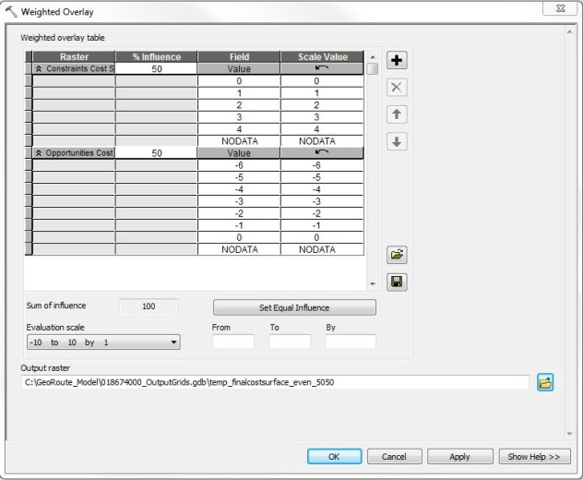
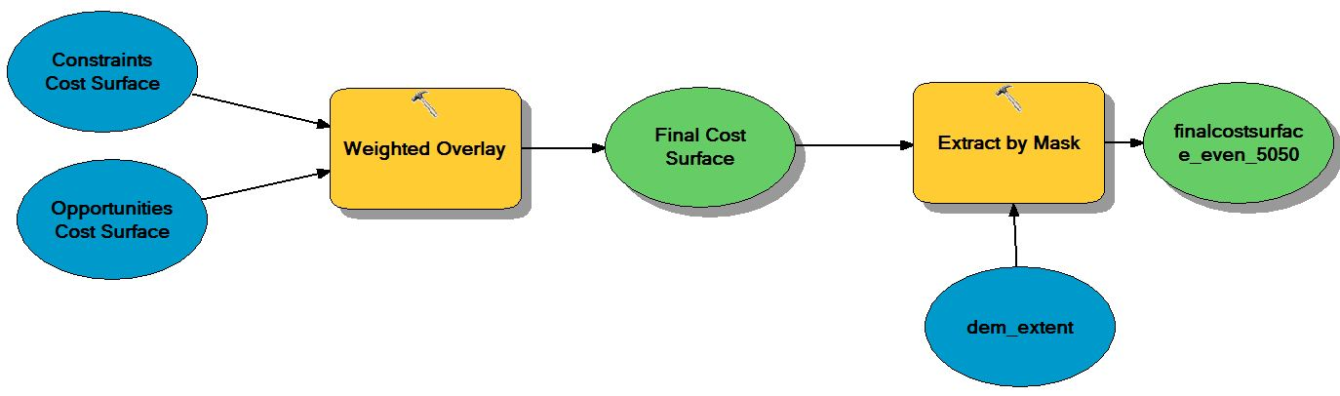
GeoRoute Selection Model
%
%

Slide 37
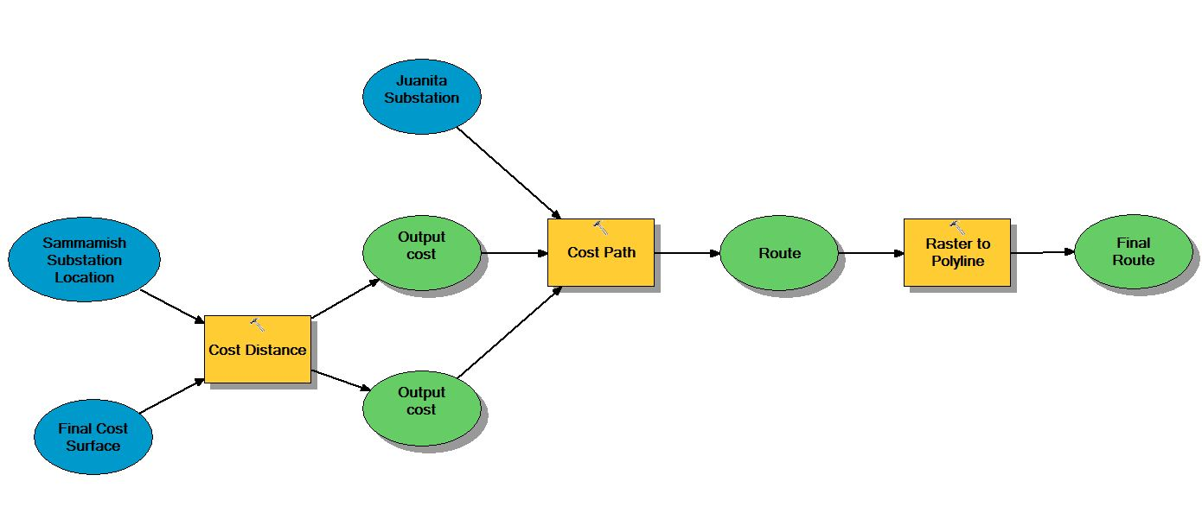
GeoRoute Selection Model
Least Cost Path Model

Slide 38
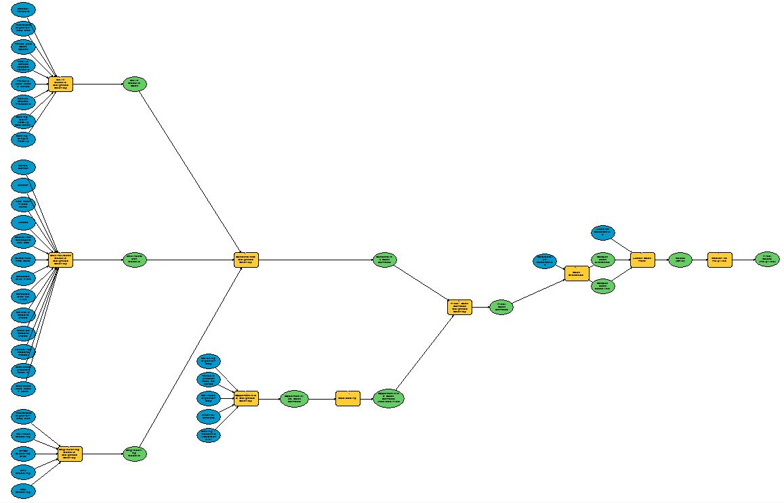
GeoRoute Selection Model
Full Model

Slide 39
Alternate Routes
GeoRoute Selection Model
Alternatives can be created by adjusting weights of avoidance rasters
  Built = 50%, Nat Env = 30%, Engineering = 20%
  Built = 20%, Nat Env = 70%, Engineering = 10%
Or by adjusting combined avoidance and opportunities
  Avoidance = 50%, Opportunities = 50%
  Avoidance = 80%, Opportunities = 20%
Route Examples

Slide 40
Public Involvement
GeoRoute Selection Model
Model works but has lots of moving parts and can be confusing to an audience
Need to simplify interface
Solution
  Export model to Python
  Develop ArcMap extension using C#
  Extension hooks in to Python

Slide 41
Conclusion
GeoRoute Selection Model
Model allows PSE to easily compare alternate routes
Model is transparent and reproducible
Data is from authoritative sources and defensible
Solution allows for public input and allows public to see the results immediately

Slide 42
Questions?
GeoRoute Selection Model
Gene Lohrmeyer
GeoEngineers
glohrmeyer@geoengineers.com
425-861-6000

